Slide 1

Laptop Price Prediction
A Machine Learning Approach
P. Sailaja
Unified Mentor 24-12-2024

Slide 2

Problem Statement: The Need for Price Prediction
Benefits for Buyers
Make informed purchases to find fair prices.
Benefits for Sellers
Use competitive pricing to increase profits.

Slide 3

Why Predict Laptop Prices?
Wide Price Variance
Market Dynamics
Different configurations and brand values affect pricing.
Prices fluctuate with new models and promotions.
Consumer Demand
Shoppers seek the best deals and value.

Slide 4

Objective: Accurate Price Prediction
Machine Learning Model
Develop robust predictive algorithms.
Key Specifications
Include RAM, CPU, brand, and more for prediction.
High Accuracy
Minimize error for reliable pricing.

Slide 5

Dataset Description: Laptop Specification Data
Data Source
Kaggle Laptop Price Dataset
Rows
1275
Columns
23
Target Variable
Price in Euros

Slide 6
Key Features for Prediction
Categorical Features
Numerical Features
Derived Features
Brand
RAM (GB)
Is Gaming Laptop?
CPU
Screen Size (inches)
Screen Resolution (pixels)
GPU
SSD (GB)
Total Storage
Operating System
Price (Euros)
Pixel Per Inch

Slide 7

Data Preprocessing: Cleaning and Preparation
Missing Values
Duplicate Removal
The Dataset has no Missing Values.
No Duplicate rows too.
Outliers Detection and Handling
Detected and Handled Outliers with IQR.

Slide 8
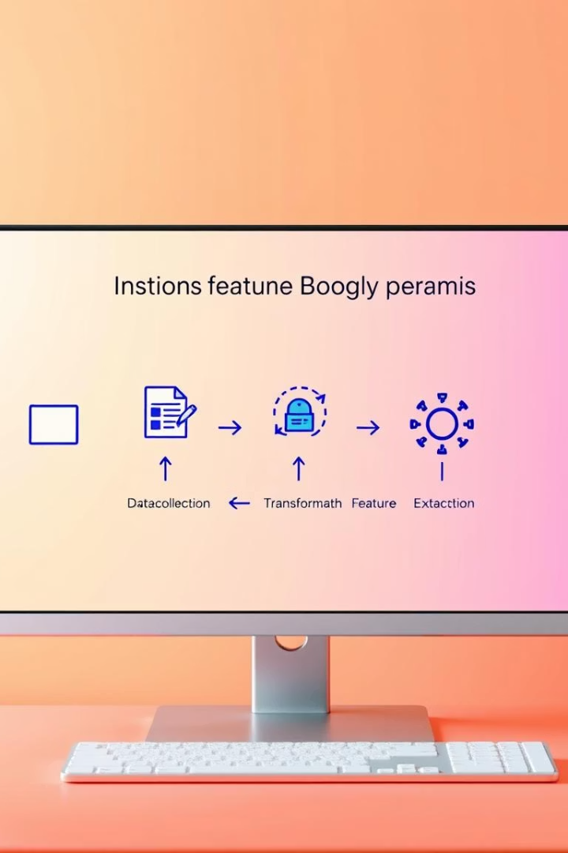



Feature Engineering:
Feature Creation
Feature Trans-formation
Feature Selection
Created new features with existing features.
One-Hot Encoding, Label Encoding, Ordinal Encoding were used.
Selected the important features by removing duplicated and constant features.

Slide 9
Model Building
Algorithms Used
Train-Test Split
Linear Regression
Partitioned the data with different models for training and validation and then made predictions.
Random Forest
XGBoost

Slide 10

Model Evaluation
Metrics
RMSE and R² score to measure accuracy.
Best Model
Optimzed the XGBoost model for better Performance.

Slide 11
Result and Predictions
Linear Regression:
MSE: 0.004944393280962755
RMSE: 0.07
R²: 0.8179989056029429
Random Forest:
MSE: 0.0023037172292978943
RMSE: 0.05
R²: 0.9152011110184317
XGBoost:
MSE: 0.002061799296928631
RMSE: 0.05
R²: 0.9241060111636131

Slide 12
Challenges Faced in Prediction
Feature Selection: Identifying the most relevant laptop attributes for prediction.
Multicollinearity: Managing correlations among features to improve model stability.
Model Optimization: Optimizing the model for better performance.
Numerical Feature Transformations: Transforming numerical features with Log, Square root, Box-Cox, Log1p.

Slide 13
Conclusion & Future Work
Summary
Future Enhancements
Next Steps
Our optimized models accurately predict laptop prices using key features.
Incorporate more diverse datasets and refine feature engineering techniques.
Deploy models for real-time pricing and explore additional machine learning methods.

Slide 14
Q&A
Discussion
Clarifications
Feedback
Open floor for queries about laptop price prediction methodology.
Address questions on data preprocessing, modeling, and results.
Invite suggestions for future enhancements and project deployment.

Slide 15
Contact Details
Email: sailajapasupuleti3112@gmail.com
Phone: +91 8688491169
GitHub link:P-Sailaja/Laptop_Price_Prediction_Project

